Slide 1

Paddy Disease Classification using Deep Learning
Revolutionizing Agriculture through Artificial Intelligence
Agri-Tech Solutions | 2026

Slide 2

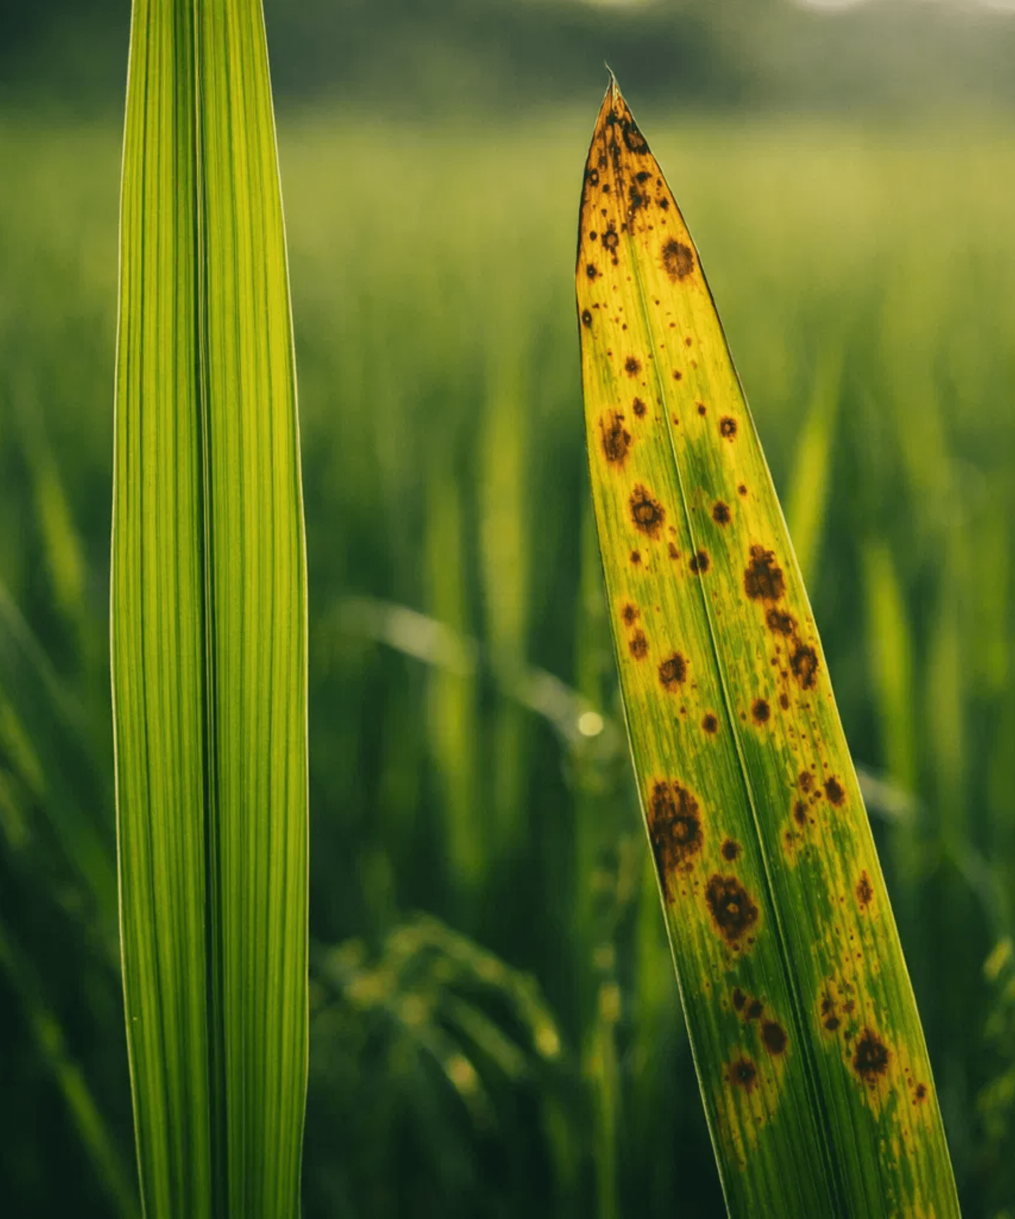
Early Detection is Critical for Global Food Security
30% Yield Reduction
Paddy diseases can devastate crop yields if left untreated, threatening local and global food supplies.
Manual Inspection Limits
Traditional methods are slow, labor-intensive, and highly prone to human error and inconsistency.
The AI Solution
Deep learning offers a scalable, rapid, and automated way to identify diseases like Bacterial Leaf Blight.

Slide 3

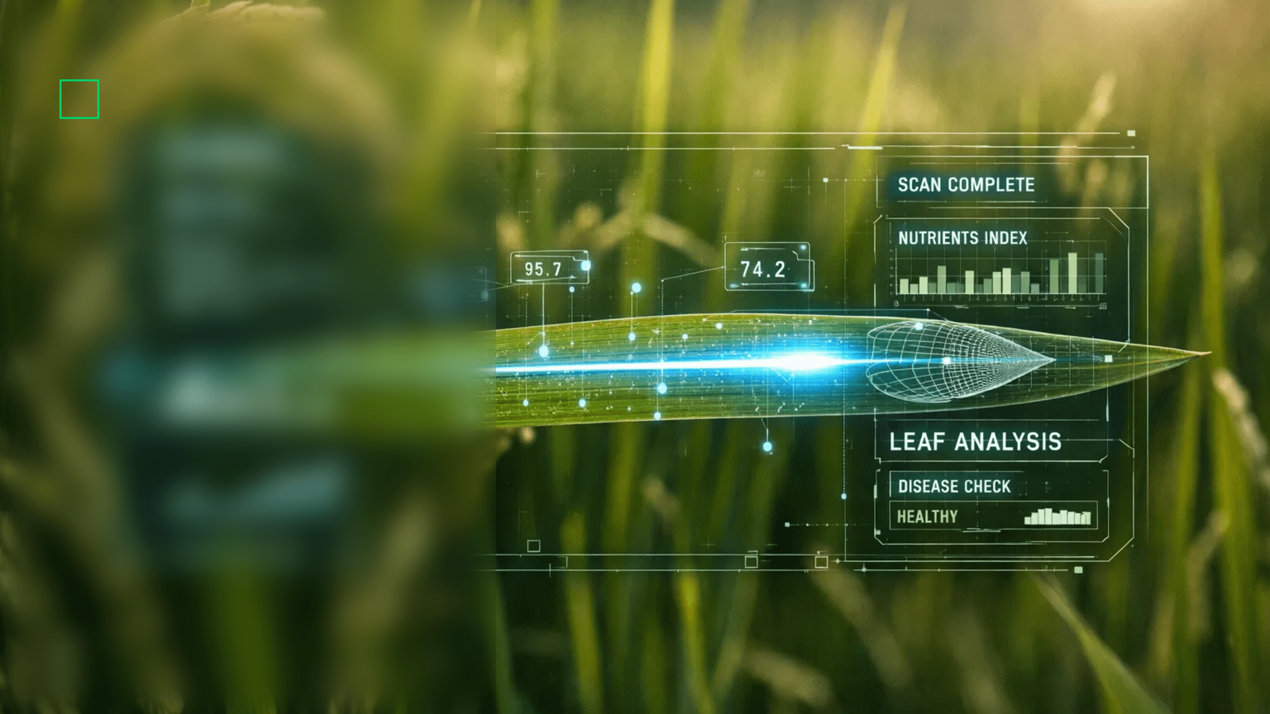
Digital Scanning Bridges the Gap Between Field and Data
High-Resolution Imaging
Capturing subtle visual features of leaf pathology that are invisible to the naked eye.
Multi-Spectral Analysis
Identifying chlorophyll levels and moisture content alongside visual symptoms.
Digital Transformation
Converting physical biological samples into rich digital assets for deep learning analysis.

Slide 4


Convolutional Neural Networks (CNNs) Power Visual Intelligence
Feature Extraction
Convolutional Layers
Automatically identifying low-level features like edges, textures, and color gradients on the leaf surface.
Spatial Reduction
Pooling Layers
Reducing data dimensions while preserving critical diagnostic patterns for efficient processing.
Classification
Fully Connected Layers
Synthesizing extracted features to classify the specific disease with high statistical precision.

Slide 5

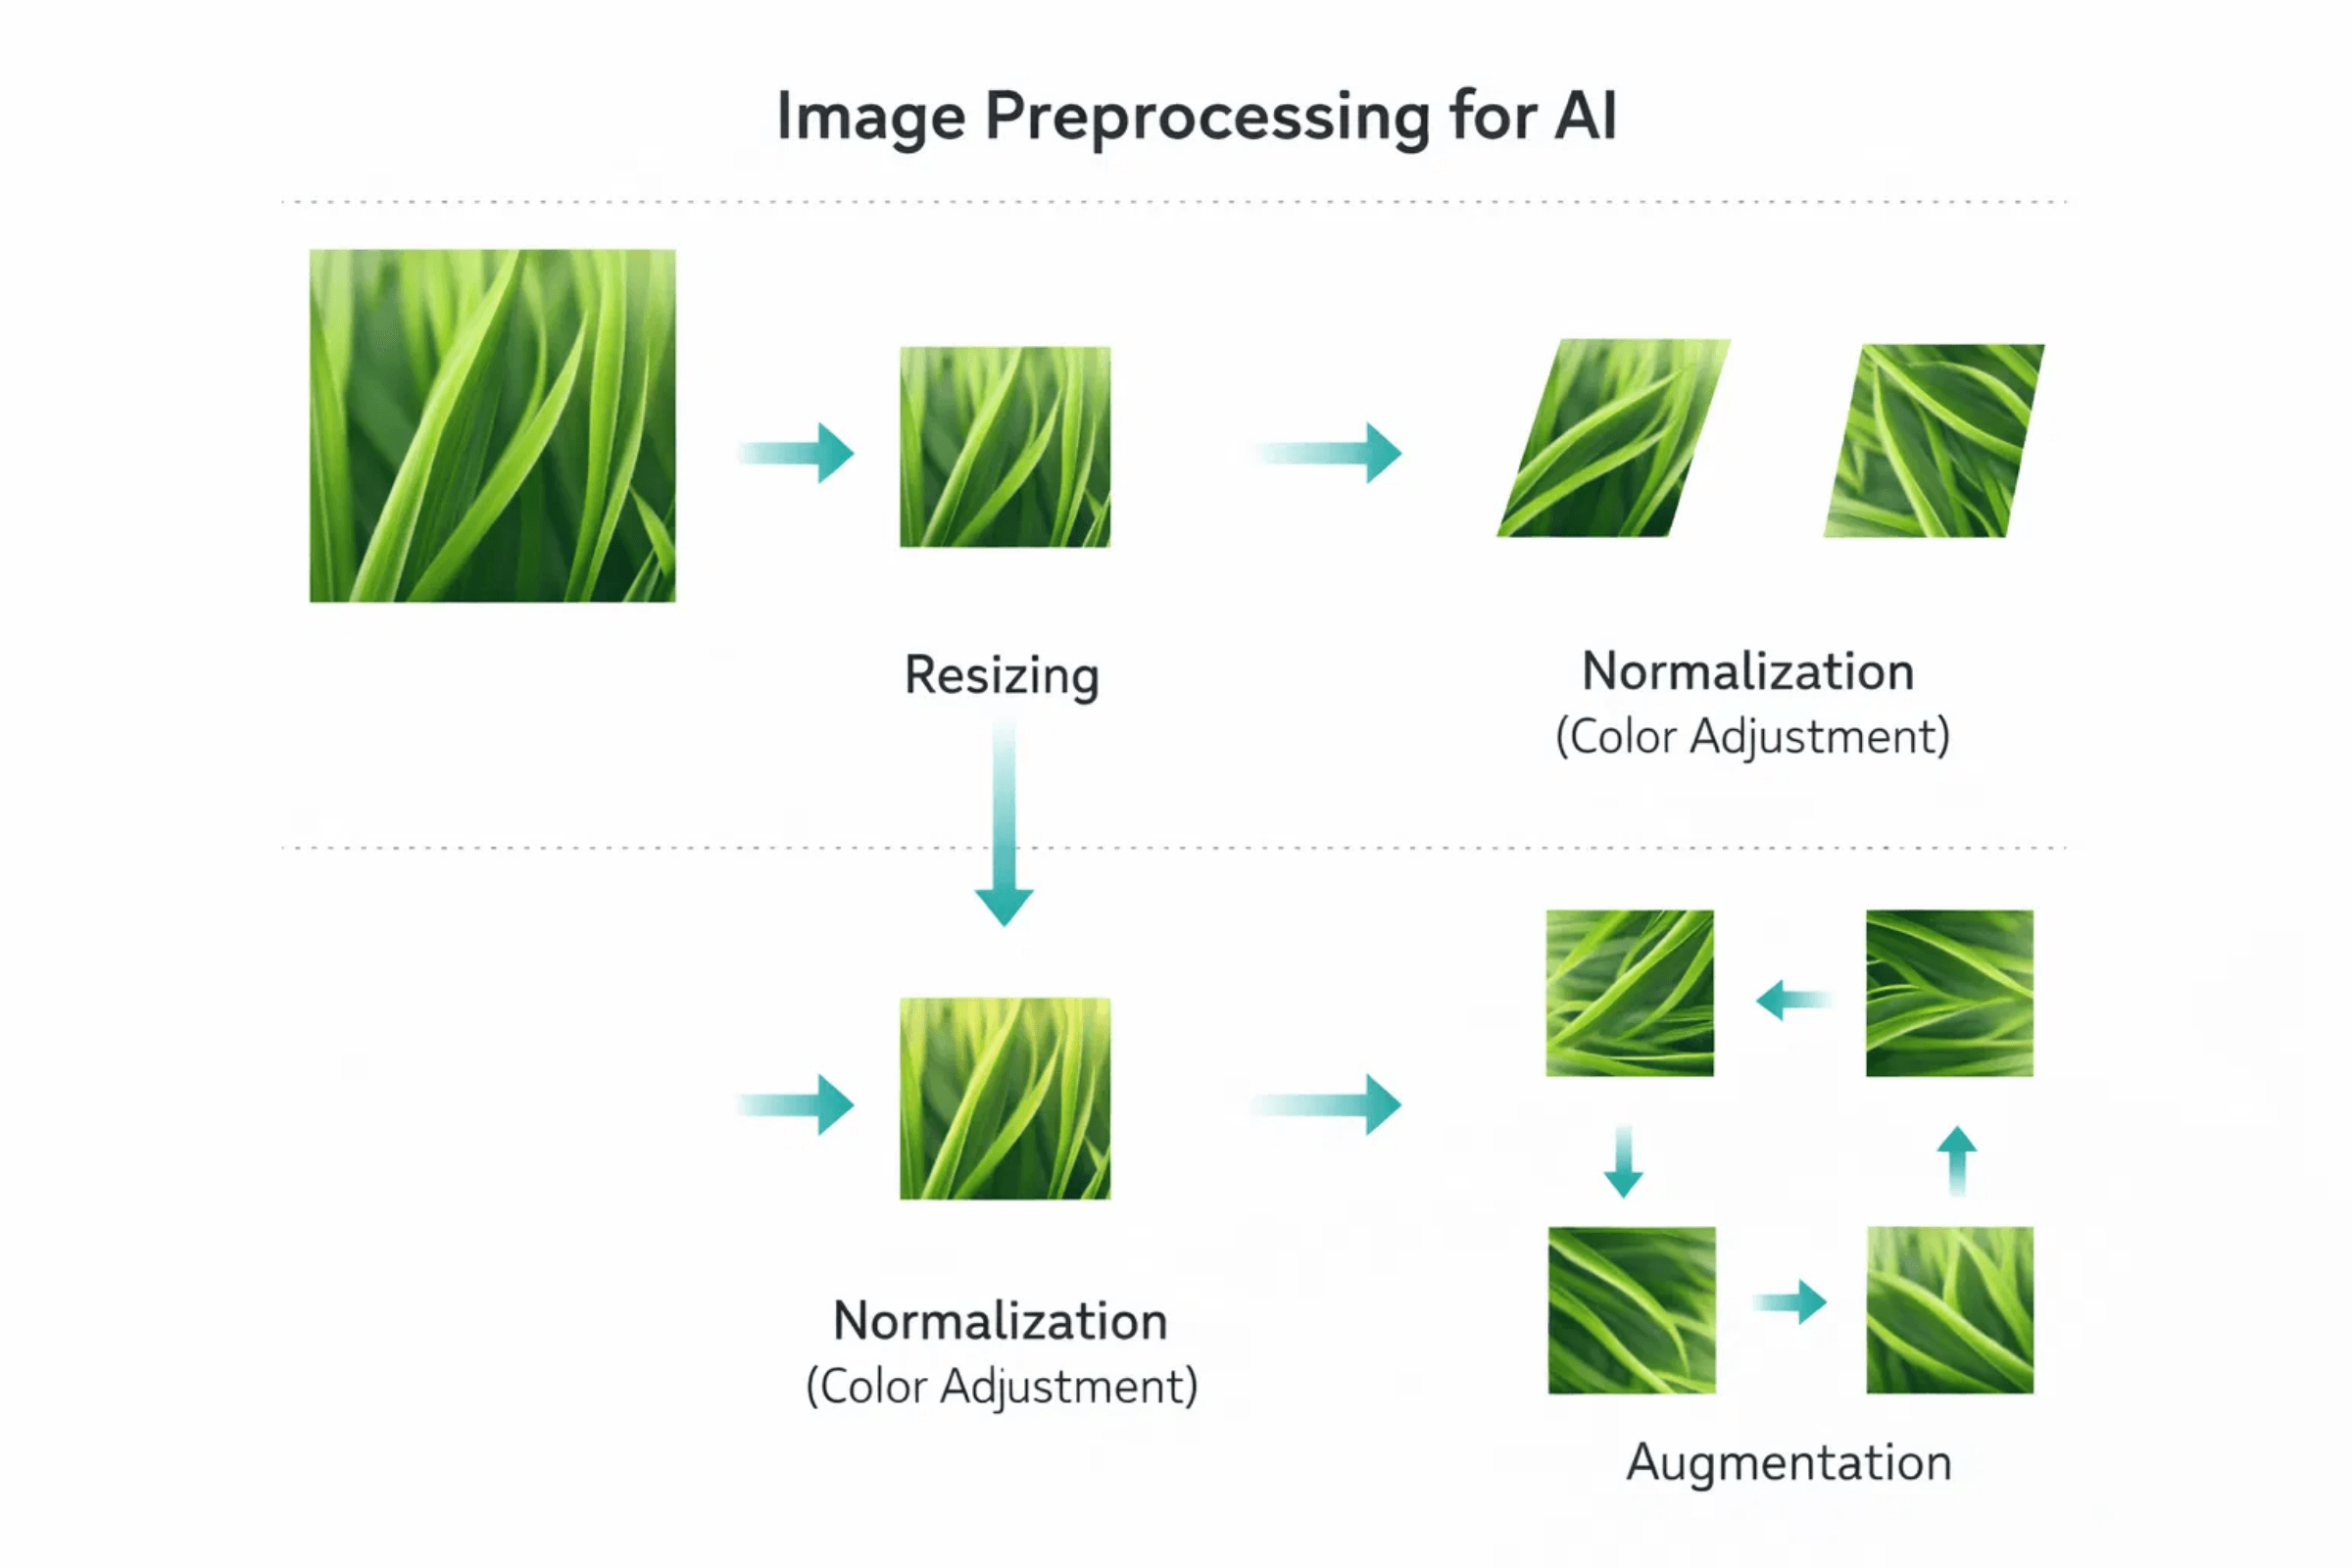
Data Pipeline
Robust Preprocessing Ensures Model Accuracy and Generalization
Resizing & Normalization
Standardizing input dimensions and pixel value ranges ensures consistent feature extraction across the neural network.
Data Augmentation
Techniques like rotation, flipping, and zooming artificially expand the dataset, helping the model generalize to varied field conditions.
Noise Reduction
Advanced filters remove environmental artifacts and lighting variations, focusing the AI on critical disease symptoms.

Slide 6


Model Optimization
GPU-Accelerated Training Enables Rapid Model Iteration
High-Performance Computing
Modern GPUs handle massive parallel computations, reducing training cycles from days to mere hours for complex architectures.
Convergence Monitoring
Real-time tracking of loss and accuracy curves ensures the model optimizes correctly without overfitting to training data.
Validation & Reliability
Rigorous testing on unseen datasets guarantees that the model performs with high precision in diverse real-world field conditions.

Slide 7

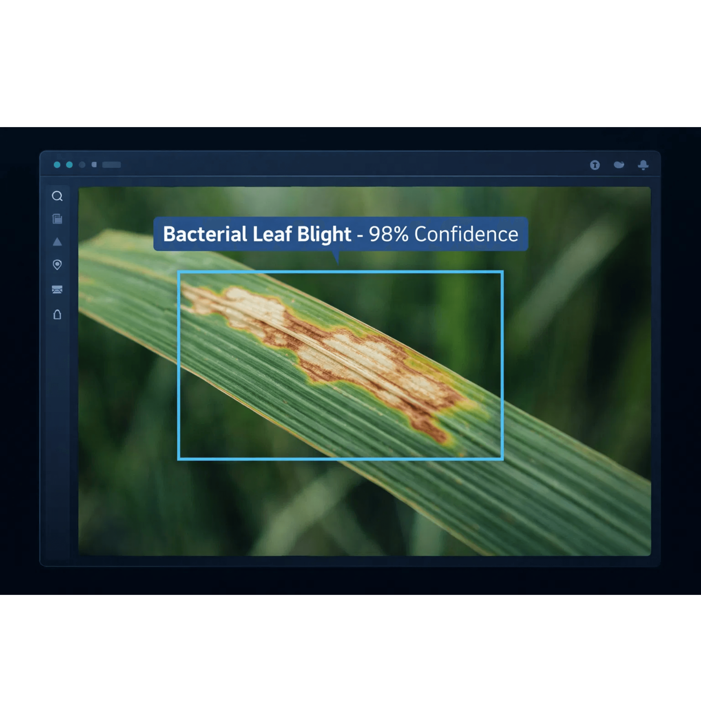
Inference Complete
Real-Time Inference Delivers Instant Diagnostic Results
Millisecond Processing
Optimized AI models provide high-confidence predictions in milliseconds, enabling rapid field assessments.
Spatial Localization
Digital bounding boxes precisely highlight the location and extent of diseased tissue on the leaf surface.
Confidence Scoring
Probability scores offer a measure of certainty, helping agronomists make informed decisions on treatment.

Slide 8


Field Implementation
Edge Deployment Empowers Farmers at the Last Mile
Mobile-Optimized Models
Lightweight architectures like MobileNet enable high-performance inference on standard smartphones without specialized hardware.
Offline Accessibility
On-device processing ensures that farmers in remote areas can access critical diagnostics even without an active internet connection.
Knowledge Democratization
Putting expert-level diagnostic tools directly into the hands of farmers, enabling immediate action to protect crop yields.

Slide 9

The Future of Agri-Tech is Intelligent and Sustainable
Resource Efficiency
Proactive Protection
Global Resilience
AI-driven insights lead to targeted pesticide application, reducing environmental impact and lowering operational costs.
Continuous monitoring and early alerts prevent large-scale crop failures, ensuring stable income for farming communities.
Integrating AI into the agricultural workflow is the key to building a more resilient and secure global food system.
Advancing Agriculture Through Innovation

